Slide 1
Chatham County Hazardous Substance Ordinances

Slide 2
Unique Ordinances
There are two ordinances unique to Chatham County, GA regarding Hazardous Substances
Chatham County Code, Chapter 21, Article VIII §21-800 – Report of Spill or Release of Hazardous Substance or Oil
Chatham County Code, Chapter 21, Article X §21-1000 – Payment of Registration Fee by Facilities with Hazardous Substances
All of the ordinances are easily viewable on www.lepc.com

Slide 3
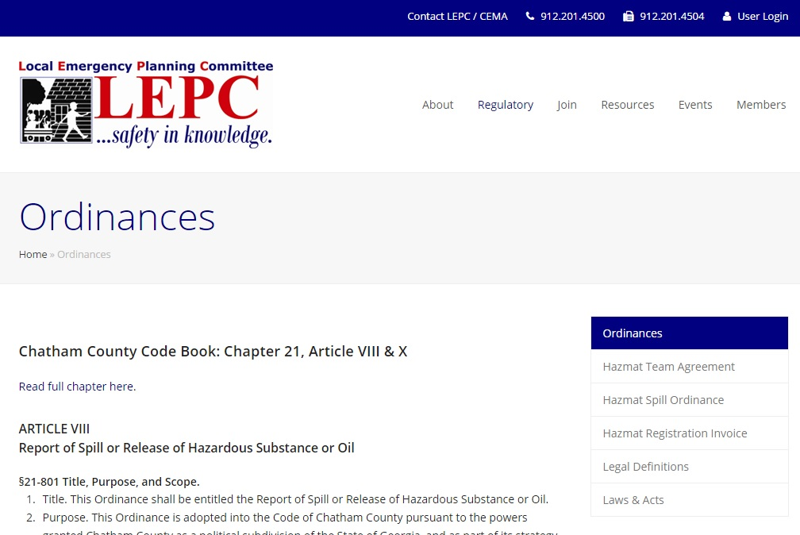

Slide 4
Article VIII: Report of Spill or Release of Hazardous Substance or Oil
The most common misconception in reporting requirements are the legal definitions. Let’s look at the terms used in the local ordinance…
“Reportable quantity” means the amount of a hazardous substance which, if released into the environment in such quantity within any 24 hour period, must be reported to the division in the event of a spill or release. The reportable quantity for mixtures is the amount of the hazardous substance components of a mixture. ~O.C.G.A. 12-14-1 (2010)

Slide 5
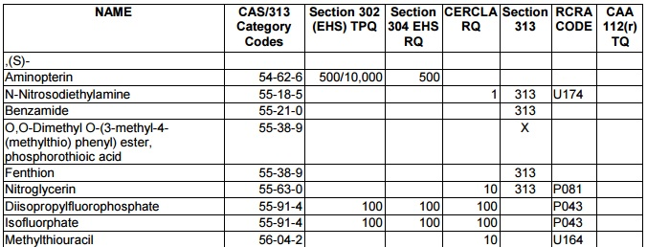
How do I know what the Reportable Quantity (RQ) for a particular substance is?
The easiest way to figure that out is to google “list of lists”. Then click on the EPA website. The list changes somewhat frequently, so please be sure to check back often.
If no specific RQ is given, the default threshold is 10,000 lbs.

Slide 6
Article VIII: Report of Spill or Release of Hazardous Substance or Oil
“Spill or release” means the discharge, deposit, injection, dumping, spilling, emitting, releasing, leaking, or placing of any hazardous substance into the air or into or on any land or water of the state, except from an underground storage tank and all plumbing and piping relating thereto or except high-level or low-level radioactive waste from a federally licensed nuclear facility or as authorized by state or federal law or a permit from the division. This term shall also mean the discharge of oil into waters of this state which will cause a significant film or sheen upon or discoloration of the surface of such waters or adjoining shorelines or cause a sludge or emulsion to be deposited beneath the surface of such waters or upon adjoining shorelines. ~O.C.G.A. 12-14-1 (2010)

Slide 7
Article VIII: Report of Spill or Release of Hazardous Substance or Oil
“Facility” means (1) any building, structure, installation, equipment, pipe or pipeline (including any pipe into a sewer or publicly owned treatment works), well, pit, pond, lagoon, impoundment, ditch, landfill, storage container, motor vehicle, rolling stock, or aircraft, or (2) any site or area where hazardous substance has been deposited, stored, disposed of, or placed, or otherwise come to be located; but does not include any consumer product in consumer use or any vessel. ~40 CFR 302.3

Slide 8
Article VIII: Report of Spill or Release of Hazardous Substance or Oil
§21-803 Incident, Defined: An “incident” is defined herein as a known or suspected spill or release of a reportable quantity of a “hazardous substance” and the known or suspected spill or release of oil which has left the boundaries of the facility where stored or used.

Slide 9
Ok, I had an incident… now what?
§21-804 Notification Requirements. Upon the occurrence of an incident as defined herein, where such incident is known or suspected, notification shall be by immediate telephone call to 911. “Immediate” as defined herein shall be within fifteen minutes of a person learning of such an incident.
Dispatch will then make notifications to law enforcement, fire and CEMA.
CEMA will contact the Responsible Party for a written follow-up report. Written follow-up reports must be completed within two business days.

Slide 10
What is required in the written follow-up report?
In paragraph form, describe the incident. Ensure information regarding the bullets below are included.
The incident and the action causing the incident
Any known or anticipated acute or chronic health risks associated
Advice regarding medical attention necessary for exposed individuals.
Proper precautions to take as a result of the release, including evacuation
Actions taken to respond to and contain the release
Any known or anticipated acute or chronic health risks associated

Slide 11
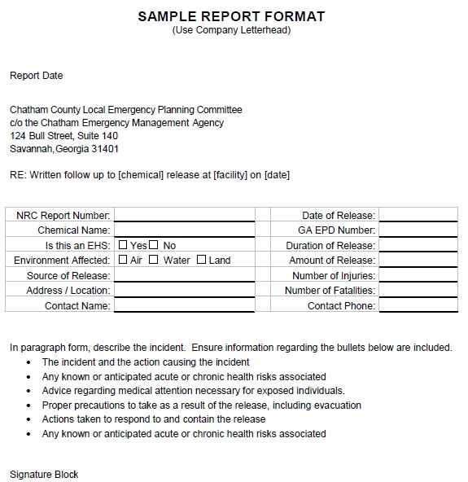

Slide 12
What if I don’t report an incident, or don’t provide a written follow-up report in a timely manner?
§21-806 Penalties. Violation of this Ordinance shall be subject to being fined upon conviction thereof by the Recorder’s Court of Chatham County in an amount not to exceed $1,000 for each violation. Each failure to report a release or discharge of reportable quantity shall be considered a separate violation.

Slide 13
Any questions regarding Hazardous Substance spill reporting?

Slide 14
Article X: Payment of Registration Fee by Facilities with Hazardous Substances
Why do we have to register our facility? Why do some facilities require a registration fee?
The intent of this Ordinance is to require the payment of a registration fee by facilities using over 10,000 pounds of hazardous substances for the reasonable cost of the HazMat Team for promoting the health, safety and welfare of the public, pursuant to O.C.G.A. §48-13-9.
An additional intent is to require registration, but no fee by facilities using hazardous substances under 10,000 pounds.

Slide 15
Article X: Payment of Registration Fee by Facilities with Hazardous Substances
§21-1003 Hazardous Substances Registration. Every person and every facility required to report annually to the Georgia Emergency Response Commission and the Chatham County Local Emergency Planning Committee in compliance with §312 Superfund Amendments and Reauthorization Act (SARA III) shall register with Chatham County through the Inspections Department no later than May 1st of each year. Such registration shall be done by the Chatham Emergency Management Agency Hazardous Materials Analyst, shall be valid for 12 months from the date of registration and shall be maintained permanently at the site of the facility.

Slide 16
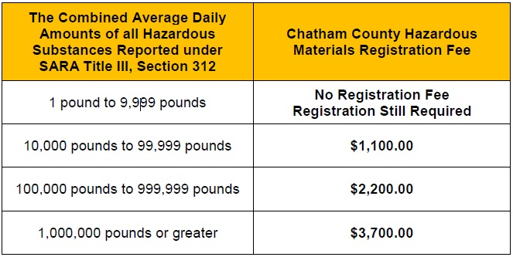
Article X: Payment of Registration Fee by Facilities with Hazardous Substances
§21-1004 Registration Fees. Registration fees shall be assessed on the basis of the combined average daily amounts of all hazardous substances as reported for the previous calendar years to the Georgia Emergency Response Commission and the Chatham County Local Emergency Planning Committee. Fee rates shall be based on the following scale:

Slide 17
Article X: Payment of Registration Fee by Facilities with Hazardous Substances
The failure of any person to register or to pay the hazardous substance fee by not later than May 1st of each year shall result in the requirement of payment of the original fee due plus a 25% delinquency fee increase of the amount which would have been due if timely paid, said delinquency fee amount not to exceed $1,000. Failure to pay timely the registration fee or delinquency fee shall be enforceable in the Recorder’s Court of Chatham County. (Amended July 01, 2011)

Slide 18
Exemptions…
1. Persons and facilities whose only hazardous substances subject to the reporting requirements cited above in compliance with §312 Superfund Amendments and Reauthorization Act (SARA III) are petroleum products (e.g. gasoline, diesel or oil) held only for retail sale to the general public.
2. Units, divisions, agencies, authorities, commissions of local, state or federal governments.
3. A critical facility which stores petroleum products (e.g. gasoline, diesel or oil) for use during an emergency. Only the petroleum products used for emergency operations will be considered for exemption. (Amended November 20, 1998)
4. A business which is regulated by the Georgia Public Safety Commission. (Amended November 20, 1998)

Slide 19
Article X: Payment of Registration Fee by Facilities with Hazardous Substances
§21-1005 Inspections. The HazMat Team shall perform inspections in accordance with the rules and regulations under §312 Superfund Amendments and Reauthorization Act (SARA III), or upon the request of a registered facility.

Slide 20
OK… I need to register… how do I do it?
That’s the simple part! It’s an easy 3 step process…
It is extremely important to ensure the contact information that you have submitted within e-Plan is correct and current!!!
Keep in mind that the average daily quantity is calculated in WEIGHT (pounds), not gallons, grams, kilos etc… Some math may be required on your part.

Slide 21
Step 1: File on e-Plan
File your facility’s information onto e-Plan
www.erplan.net
File by March 1st each year

Slide 22
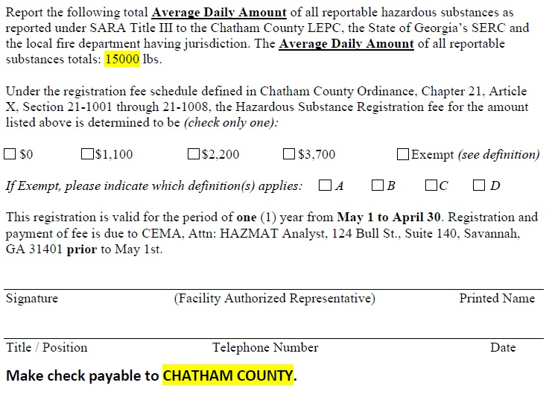
Step 2: Fill out invoice and return to CEMA
CEMA will send an invoice to the contacts listed in e-Plan.
Fill out invoice
Must be postmarked by May 1st

Slide 23
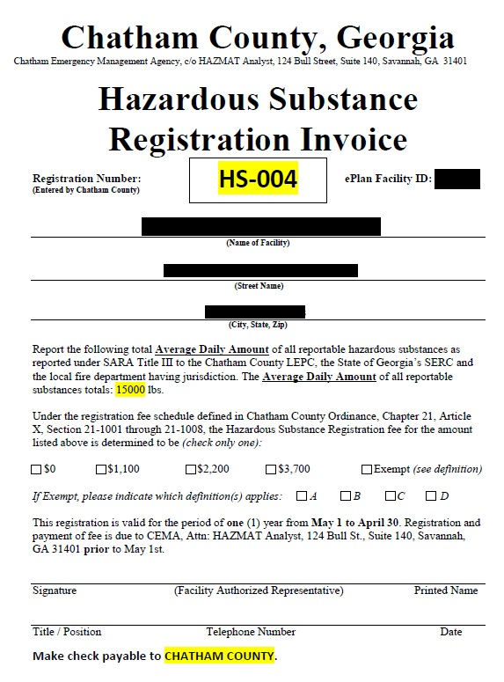

Slide 24
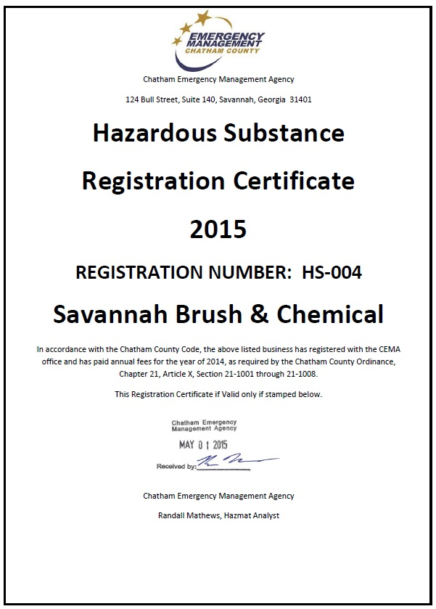
Step 3: Display completed Certificate

Slide 25
Any questions regarding Hazardous Substance Registration, or anything else covered today?

Slide 26
Mark Adams Chatham Emergency Management Agency 912-201-4500 madams@chathamcounty.org

