Slide 1
What could possibly go wrong?

Slide 2
CASE STUDY
Company spills chemicals into drinking water
30,000 left without water
President of Freedom Industries was asked to make comments
Will review what worked with this press conference and what didn’t work
SSRC • MARCH 2, 2022

Slide 3
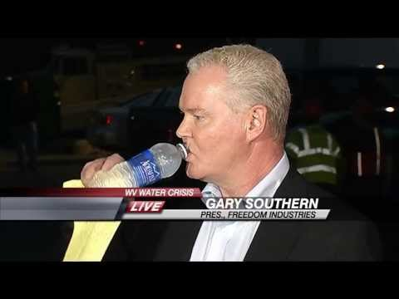

Slide 4
What could he have done differently?
He sips water throughout an interview about hundreds of thousands of residents being without water.
Hydrate before the press conference.
He looks for sympathy after an ‘extremely long day’, a statement unlikely to go down well with residents who had spent the day without water.
Focus genuine concern for the people experiencing the problem.
He failed to make and maintain eye contact. This made him look shifty and untrustworthy.
Work out where you should look and then maintain that eye contact.
He speculates on what has gone wrong and then follows it up by speculating on the cause of the leak.
Don’t speculate. Speak to the facts.
He realized how poorly he was performing as a spokesperson, decided it was time to bring it to an end and announced that it was over before starting to walk away.
Always have a press officer present to control the press conference, making it clear that the spokesperson has limited time and to manage the time for Q&A.

Slide 5
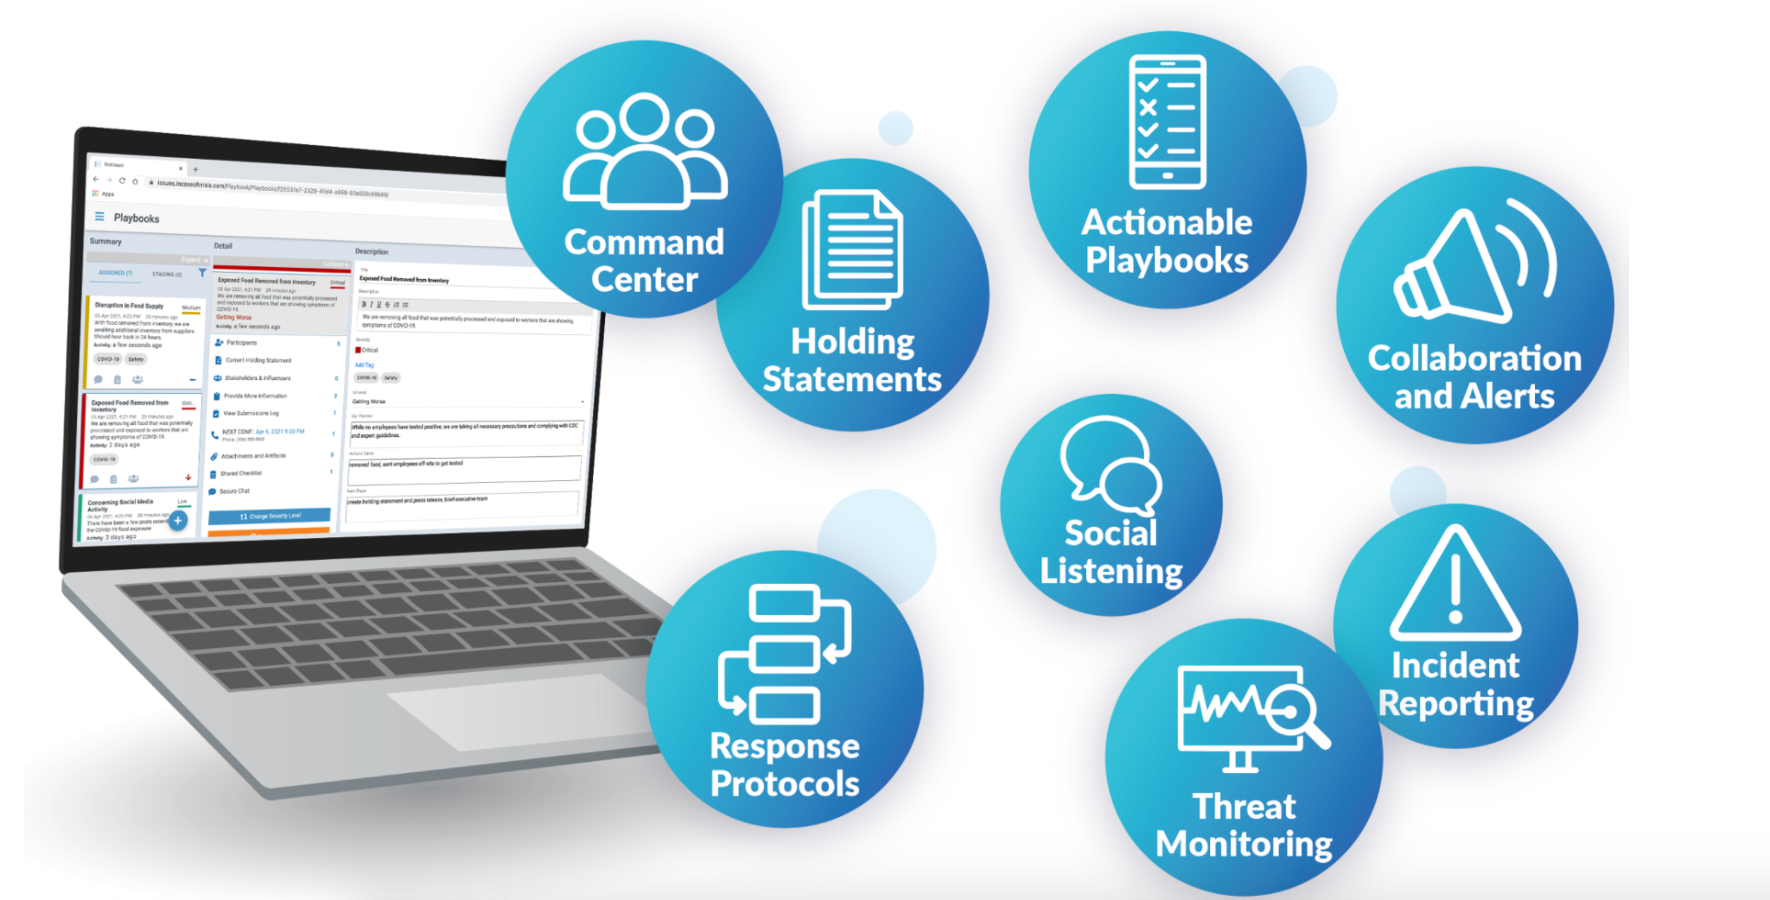
In Case of Crisis 365 is used by hundreds of organizations globally to prepare for, identify and respond to emerging threats better and faster.

Slide 6
Get the full operational picture consistently - Break down silos, instantly combining internal reports and external threat alerts to get the full picture.
Assemble your team quickly and securely - Every minute counts. Bring the right team together instantly and securely from any device. Anywhere.
Coordinate and respond effectively - Access scenario-based protocols with intelligent workflow, assign and track your progress live.
Align your key stakeholders effortlessly - Prepare and communicate with key stakeholders using actionable role-based playbooks, mass notifications, and collaboration services.

Slide 7
For More Information
Marjorie Young
Carriage Trade Public Relations® Inc.
912.844.9990
www.carriagetradepr.com
marjorie@carriagetradepr.com

